Slide 1
Max flow and flow network
FORD FULKERSON

Slide 2
FORD FULKERSON
The Ford-Fulkerson algorithm solves the maximum flow problem.
Finding the maximum flow can be helpful in many areas:
for optimizing network traffic,
for manufacturing,
for supply chain and logistics,
for airline scheduling.
Poblem Statement:
  Given a graph which reprents a flow network where every edge has a capacity.Also given two vertices source s and sink t in the graph.Find out the maximum possible flow from s to t with the following Constraints,
  a) Flow on an edge doesnt exceed the given capacity of the edge
  b)In-flow is equal to out-flow for every vertex except s and t

Slide 3
The flow comes from a source vertex (s) and ends up in a sink vertex (t), and each edge in the graph allows a flow, limited by a capacity.
The Ford-Fulkerson algorithm works by looking for a path with available capacity from the source to the sink (called an augmented path), and then sends as much flow as possible through that path.
The Ford-Fulkerson algorithm continues to find new paths to send more flow through until the maximum flow is reached.
How it works:
Start with zero flow on all edges.
Find an augmented path where more flow can be sent.
Do a bottleneck calculation to find out how much flow can be sent through that augmented path.
Increase the flow found from the bottleneck calculation for each edge in the augmented path.
Repeat steps 2-4 until max flow is found. This happens when a new augmented path can no longer be found.

Slide 4
Terminologies
Residual Graph(Network):Its a graph which indicates additional possible flow .If there such path from source to sink then there is a possibility to add flow
Residual Capacity:Its original capacity of the edge Minus flow.
Minimal Cut:Also know as bottleneck capacity,which decides maximum possible flow from source to sink through an agmented path.
Agumrnting Path:It can be done in two ways
1) Non-Full forward edge
2)Non-empty backward edges

Slide 5
Residual Network in Ford-Fulkerson
The Ford-Fulkerson algorithm actually works by creating and using something called a residual network, which is a representation of the original graph.
In the residual network, every edge has a residual capacity, which is the original capacity of the edge, minus the the flow in that edge. The residual capacity can be seen as the leftover capacity in an edge with some flow.
For example, if there is a flow of 2 in the v3→v4 edge, and the capacity is 3, the residual flow is 1 in that edge, because there is room for sending 1 more unit of flow through that edge.

Slide 6
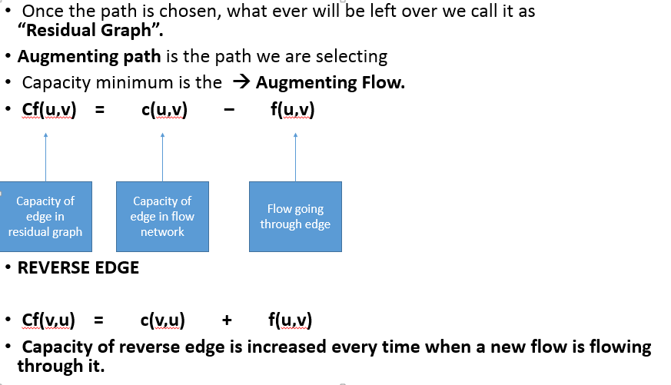

Slide 7
Reversed Edges in Ford-Fulkerson
The Ford-Fulkerson algorithm also uses something called reversed edges to send flow back. This is useful to increase the total flow.
  For example, the last augmented path s→v2→v4→v3→t the total flow is increased by one more unit, by actually sending flow back on edge v4→v3, sending the flow in the reverse direction.
Sending flow back in the reverse direction on edge v3→v4 in our example meas that this 1 unit of flow going out of vertex v3, now leaves v3 on edge v3→t instead of v3→v4
To send flow back, in the opposite direction of the edge, a reverse edge is created for each original edge in the network. The Ford-Fulkerson algorithm can then use these reverse edges to send flow in the reverse direction.
A reversed edge has no flow or capacity, just residual capacity. The residual capacity for a reversed edge is always the same as the flow in the corresponding original edge. In our example, the edge v3→v4 has a flow of 2, which means there is a residual capacity of 2 on the corresponding reversed edge

Slide 8
v4→v3
This just means that when there is a flow of 2 on the original edge v3→v4 there is a possibility of sending that same amount of flow back on that edge, but in the reversed direction. Using a reversed edge to push back flow can also be seen as undoing a part of the flow that is already created.

Slide 9
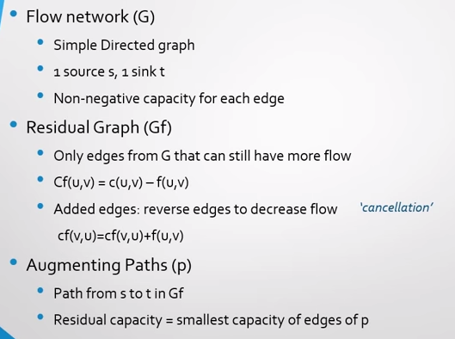

Slide 10
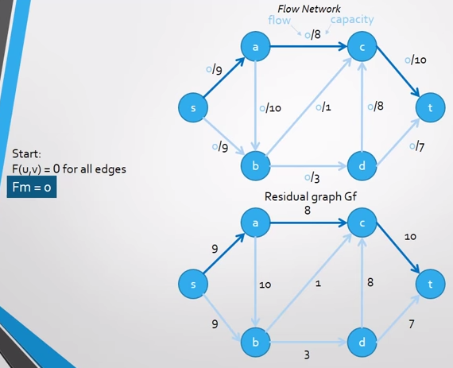

Slide 11
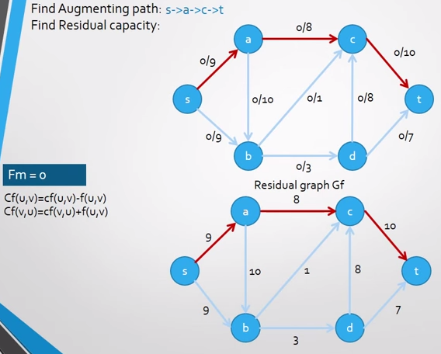

Slide 12
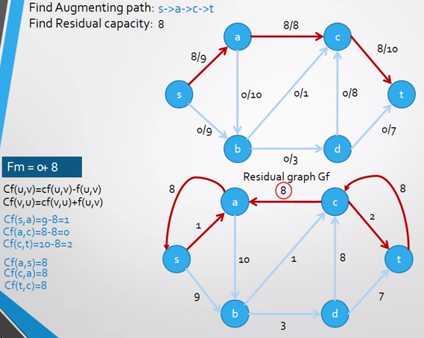

Slide 13
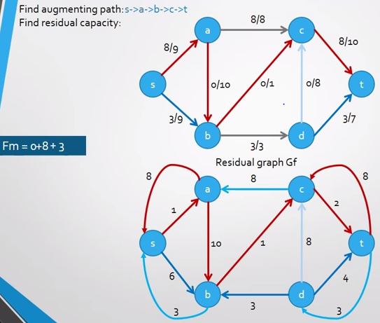

Slide 14
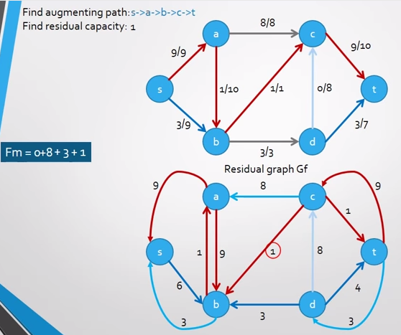

Slide 15
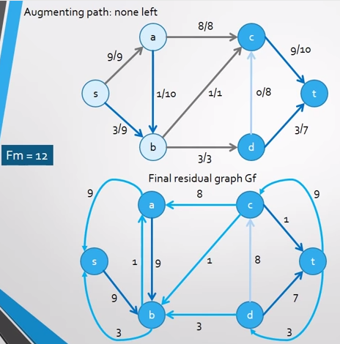

Slide 16
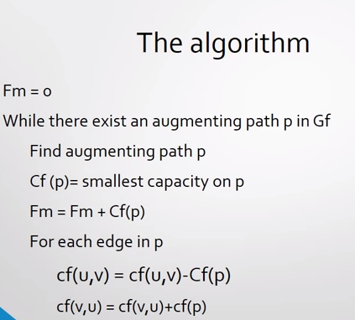

Slide 17
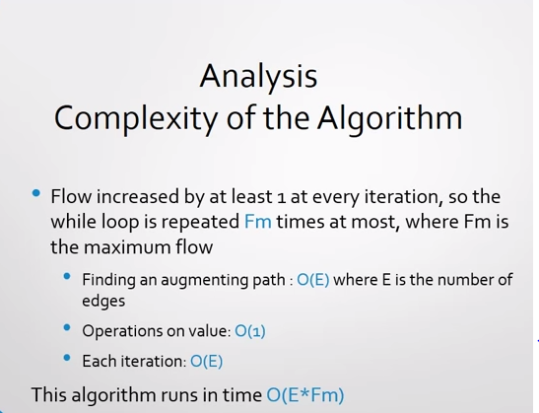
Update the maximum flow, and capacities on the edges

Slide 18
Ford-Fulkerson Max Flow
4
2
5
3
1
1
1
2
2
s
4
t
3
2
1
3
This is the original network, and the original residual network.

Slide 19
Ford-Fulkerson Max Flow
4
2
5
3
1
1
1
2
2
s
4
t
3
2
1
3
Find any s-t path in G(x)

Slide 20
Ford-Fulkerson Max Flow
4
2
5
3
1
1
1
2
1
2
s
4
t
2
1
3
2
1
1
1
3
Determine the capacity Δ of the path.
Send Δ units of flow in the path.
Update residual capacities.

Slide 21
Ford-Fulkerson Max Flow
4
2
5
3
1
1
1
2
1
2
s
4
t
2
1
3
2
1
1
1
3
Find any s-t path

Slide 22
Ford-Fulkerson Max Flow
4
2
5
3
1
1
1
2
1
1
1
s
4
t
2
1
1
3
2
2
1
1
1
1
3
1
Determine the capacity Δ of the path.
Send Δ units of flow in the path.
Update residual capacities.

Slide 23
Ford-Fulkerson Max Flow
4
2
5
3
1
1
1
2
1
1
1
s
4
t
2
1
1
3
2
2
1
1
1
1
3
1
Find any s-t path

Slide 24
Ford-Fulkerson Max Flow
4
2
5
3
1
1
1
1
1
1
s
4
t
1
2
1
2
2
3
1
1
1
1
3
1
Determine the capacity Δ of the path.
Send Δ units of flow in the path.
Update residual capacities.

Slide 25
Ford-Fulkerson Max Flow
4
2
5
3
1
1
1
1
2
1
1
s
4
t
1
2
1
2
2
3
1
1
1
1
3
1
Find any s-t path

Slide 26
Ford-Fulkerson Max Flow
4
2
5
3
1
1
1
1
2
1
1
s
4
t
1
2
1
1
2
2
1
1
1
2
1
2
3
1
Determine the capacity Δ of the path.
Send Δ units of flow in the path.
Update residual capacities.

Slide 27
Ford-Fulkerson Max Flow
4
2
5
3
1
1
1
1
2
1
1
s
4
t
1
2
1
1
2
2
1
1
2
1
2
3
1
Find any s-t path

Slide 28
Ford-Fulkerson Max Flow
4
3
2
5
1
3
1
2
1
1
1
1
s
4
t
1
2
1
1
2
2
1
1
2
1
2
3
1
Determine the capacity Δ of the path.
Send Δ units of flow in the path.
Update residual capacities.

Slide 29
Ford-Fulkerson Max Flow
4
3
2
5
1
3
1
2
1
1
1
1
s
4
t
1
2
1
1
2
2
1
1
2
1
2
3
1
There is no s-t path in the residual network. This flow is optimal

Slide 30
Ford-Fulkerson Max Flow
4
3
2
2
5
5
1
3
1
2
1
1
1
1
s
s
4
4
t
1
2
1
1
2
2
1
1
2
1
2
3
1
3
These are the nodes that are reachable from node s.

Slide 31
Ford-Fulkerson Max Flow
1
2
5
1
1
2
2
s
4
t
2
2
3
Here is the optimal flow

